Slide 1

Digital Queue Management System For Clinics/Hospitals
AfyaFlow
Project members:
Fidelity Kathure : SCT212-0718/2022
Mary Wangari : SCT212-0723/2022
Esther nyevu : SCT212-0145/2022
Roles
Project Manager
Backend Developer
Frontend Developer

Slide 2
Project definition
The Digital Queue Management System (DQMS) is a smart, automated system designed to streamline patient flow in hospitals and clinics. It eliminates the need for physical lines by organizing and managing patient queues digitally, reducing waiting times and improving hospital efficiency.

Slide 3
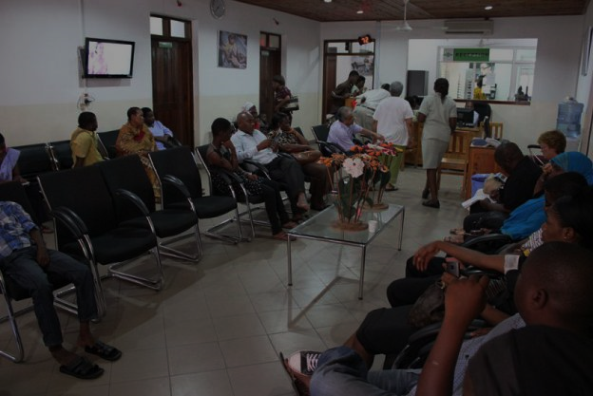
ProBLEM DEFINITION
1. Long patient wait times causing frustration. 2. Inefficient appointment and queue management. 3. No real-time updates on queue status. 4. Difficulty finding hospitals with the right services. 5. Overwhelmed staff and poor patient experience

Slide 4

THE SOLUTIONS ✔ Providing real-time queue updates so patients know when to arrive. ✔ Using AI to estimate wait times based on queue length and historical data. ✔ Helping users find hospitals nearby based on the medical services they need.

Slide 5



Expected Outcomes
✔ Patients will spend less time waiting at hospitals because they’ll know when to arrive. ✔ Appointments will be better managed, reducing last-minute cancellations. ✔ Finding hospitals and knowing what services they offer will be easier.
This

Slide 6
Existing Solutions & our uniqueness
Existing Solutions | Our Unique Features
Queuebee | AI-powered wait-time prediction
Google Maps hospital search | Real-time hospital service availability
Takashi queue management system | Remote Queue Joining (Home Booking)
Vitec solutions | system’s integration with AI thus more accurate and timely updates.

Slide 7
System Features & Functionalities
Patient Registration (Manual & Online)
Register via kiosk, website, app, or reception.
Collects name, contact, and visit purpose.
Queue Ticket Generation
Assigns digital queue numbers based on urgency and appointment type.
Real-Time Queue Updates & Notifications
Track queue position via SMS, or app.
Prioritizes critical cases like emergencies.
Integration with Hospital Systems
Syncs with EHR and hospital management systems for seamless operations.
Admin Dashboard for Monitoring & Reporting
Monitors wait times, patient flow, and efficiency in real-time.

Slide 8

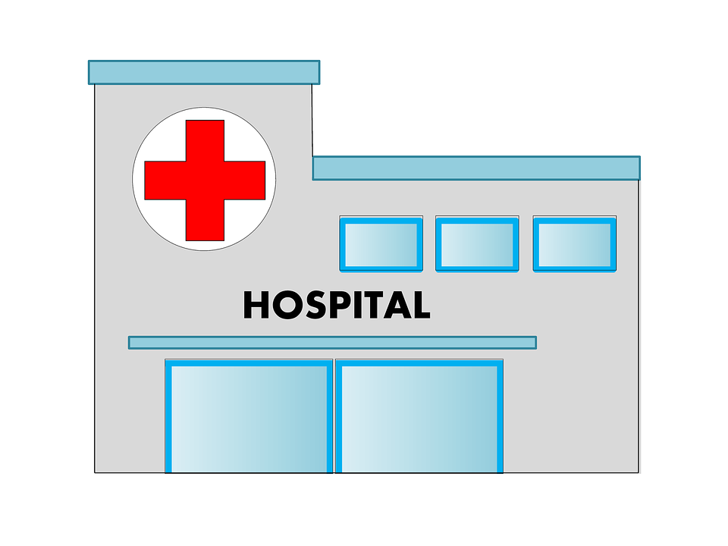
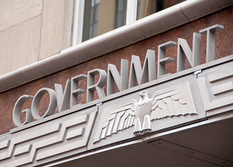
Target Market
Primary Users:
Patients
-Individuals seeking to book appointments and reduce wait times.
Secondary Users:
Hospitals and Clinics (e.g., JKUAT Hospital)
-Healthcare facilities aiming to use the system to manage queues and enhance patient satisfaction.
Government Health Agencies
Public healthcare systems looking to modernize queue management.

Slide 9

Personas in a Digital Queue Management System
Patients
Register on-site, Book online or via app. High-priority, bypass queue.
System Administrators
Analyze and optimize queues.
Healthcare Staff
Check-in, verify details, assign queue numbers and manage queues
Management & Decision Makers
Use data to improve efficiency and monitor system performance.

Slide 10

Data Sources in a Digital Queue Management System
Simulated Patient Data
Simulated Appointment Data
Simulated Queue Data
Simulated Doctor Availability Data
Open Healthcare Datasets
User Input (During Testing)
.

Slide 11
Business Model
Potential Revenue Streams:
Hospitals to pay for premium features like analytics.
Government partnerships for nationwide queue management.
Priority Booking Fees- Offer patients the option to pay for priority access
Subscription Plans for Frequent Patients- patients who frequents the hospital (e.g., chronic disease patients, elderly patients).

Slide 12
Tools and Technology
✅ Frontend: HTML, CSS, and Bootstrap for a simple, responsive interface. ✅ Backend: Django (Python) for managing queue updates and hospital searches. ✅ Database: MYSQL for data storage. ✅ AI Feature: Queue Time Prediction using Scikit-Learn. ✅ API: Google Maps API for hospital location services.

Slide 13
Conclusion
This Digital Queue Management and Hospital Finder System is a practical project that will make hospital visits smoother for patients and reduce stress for hospital staff.
Transforming Healthcare, One Queue at a Time.

